Slide 1

Tribhuvan University institute of engineering pulchowk campus
MINOR PROJECT Presentation

Slide 2
Presentation outline
Background
Introduction
Project Scope
Future enhancements
Communication with tools
Problems faced

Slide 3
Background
A single doctor in Nepalese hospital needs to treat more than 20 patients.
Only doctors or nurses can examine the patients condition.
The patient rushing to the hospital via ambulance does not always get the emergency monitoring.

Slide 4
INTRODUCTION
One medical instrument used for the examination of the heart is Electrocardiograph (ECG). ECG is a medical instrument that is commonly used by the medical team to detect heart rate and rhythm.
One of the alternative methods of measuring the heart beat of a patient is using the principle of photoplethysmography (PPG) as a non-invasive optical technique for detecting cardio-vascular pulse wave from a fingertip.

Slide 5
INTRODUCTION
It uses an infrared light source to illuminate the finger on one side, and a photodetector placed on the other side measures the small variations in the transmitted light intensity. The variations in the photodetector signal are related to changes in blood volume inside the tissue. The signal is filtered and amplified to obtain a nice and clean PPG waveform, which is synchronous with the heart beat.
For controlling the circuit, an AVR microcontroller is used that measures the pulse from the fingertip for at least 15 seconds which is used for further processing before the final output is presented in the 7-segment display.

Slide 6
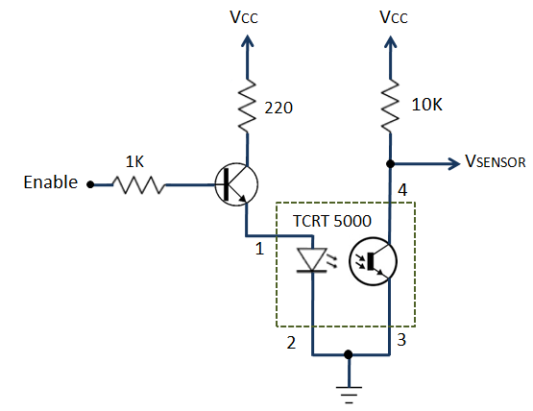

Slide 7
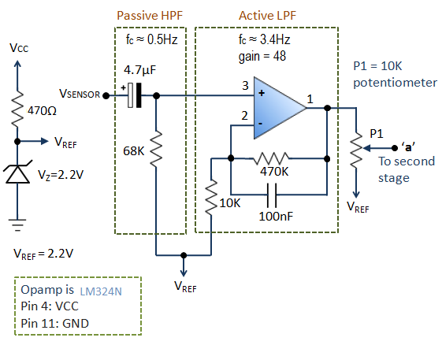

Slide 8
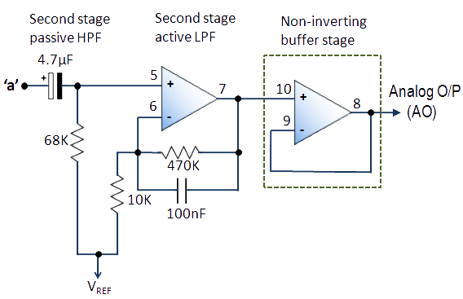

Slide 9
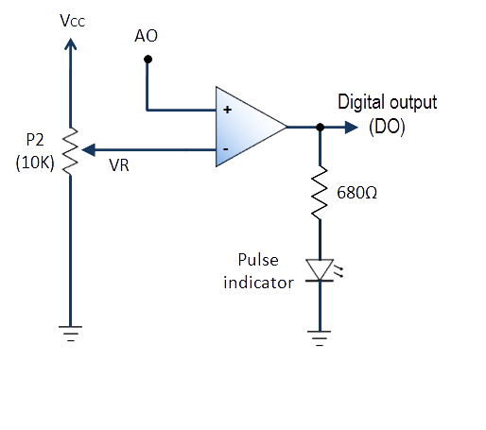

Slide 10
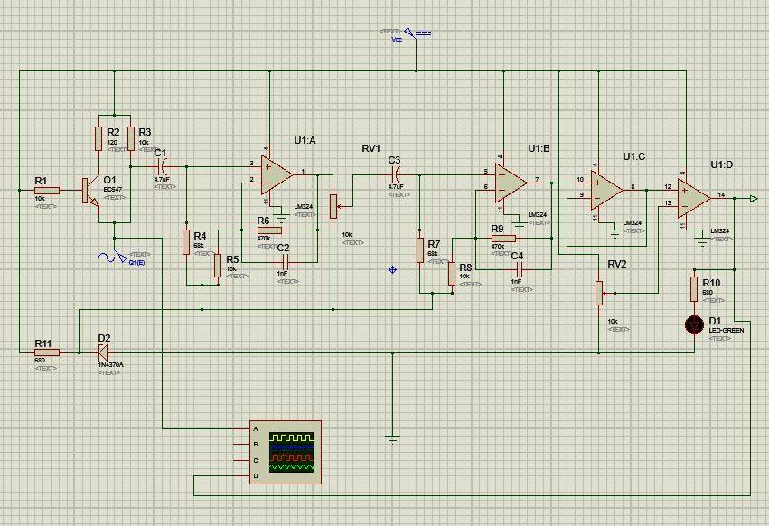
Schematic of the circuit in Proteus

Slide 11
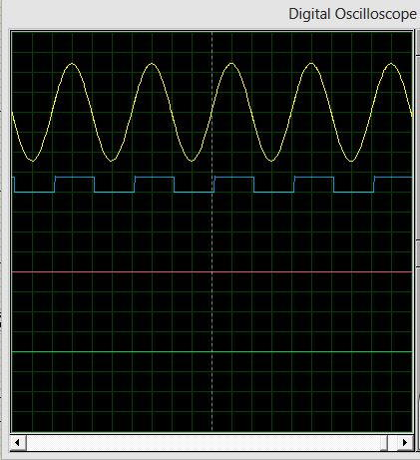
Output from a digital oscilloscope

Slide 12
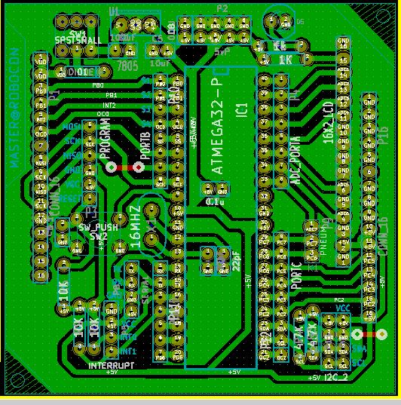
Schematic diagram of Interface circuit

Slide 13
PROJECT SCOPE
It is not always feasible for the doctors to visit and check-up every patient
With this heart rate sensor, even a layman wo may be the patient itself can measure his/her heart rate with ease
Additions to this system can allow doctors to monitor patients from a remote location as well.

Slide 14
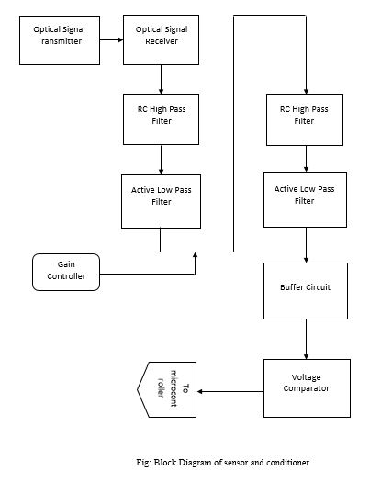

Slide 15
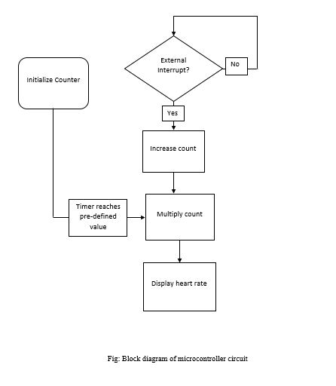

Slide 16
COMMUNICATION WITH TOOLS
For signal conditioning and pulse amplification, a passive HPF(High Pass Filter) and an active LPF(Low Pass Filter) were used twice for better results
ATmega32 was selected as the microcontroller on which the programming was to be done. Proper understanding of C language and the AVR keywords in Atmel Studio was a prerequisite.
Interfacing an LCD display to the AVR is to be thought of as well.

Slide 17
FUTURE enhancements
Addition of wireless communication systems using either Wi-Fi or GSM module
Mobile application on various OS will be added to make the system smarter
The system will be upgraded into smart patient monitoring system by adding ECG, pressure, blood sugar level and temperature monitoring as well
Addition of a GPS module for remote monitoring of patients.

Slide 18
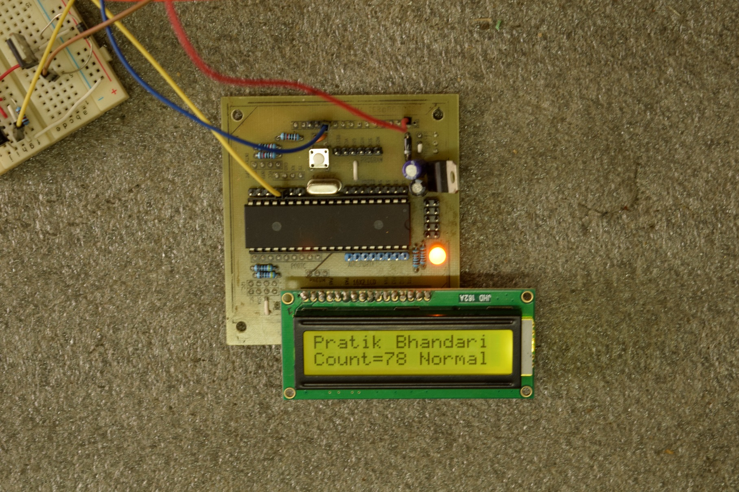
Output Results

Slide 19
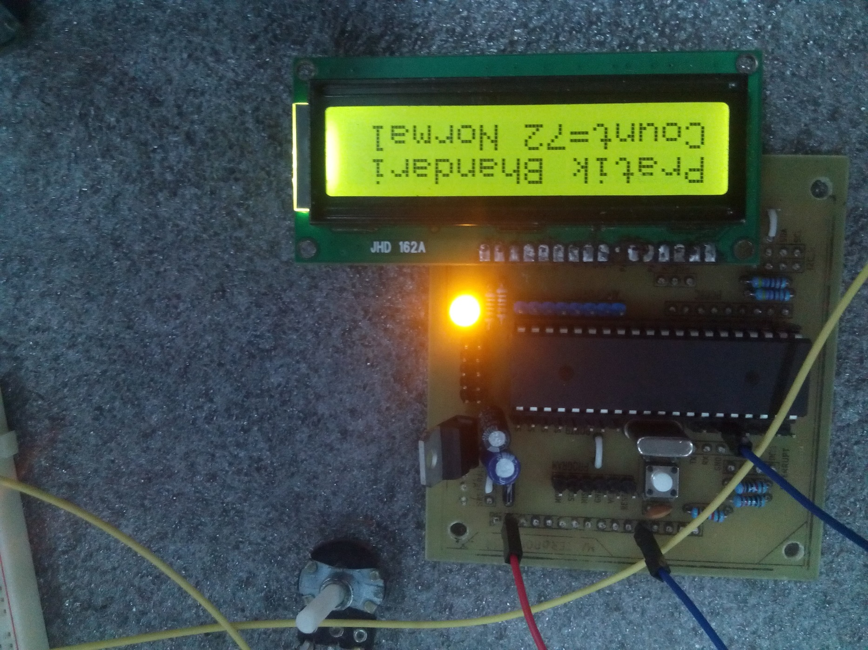

Slide 20
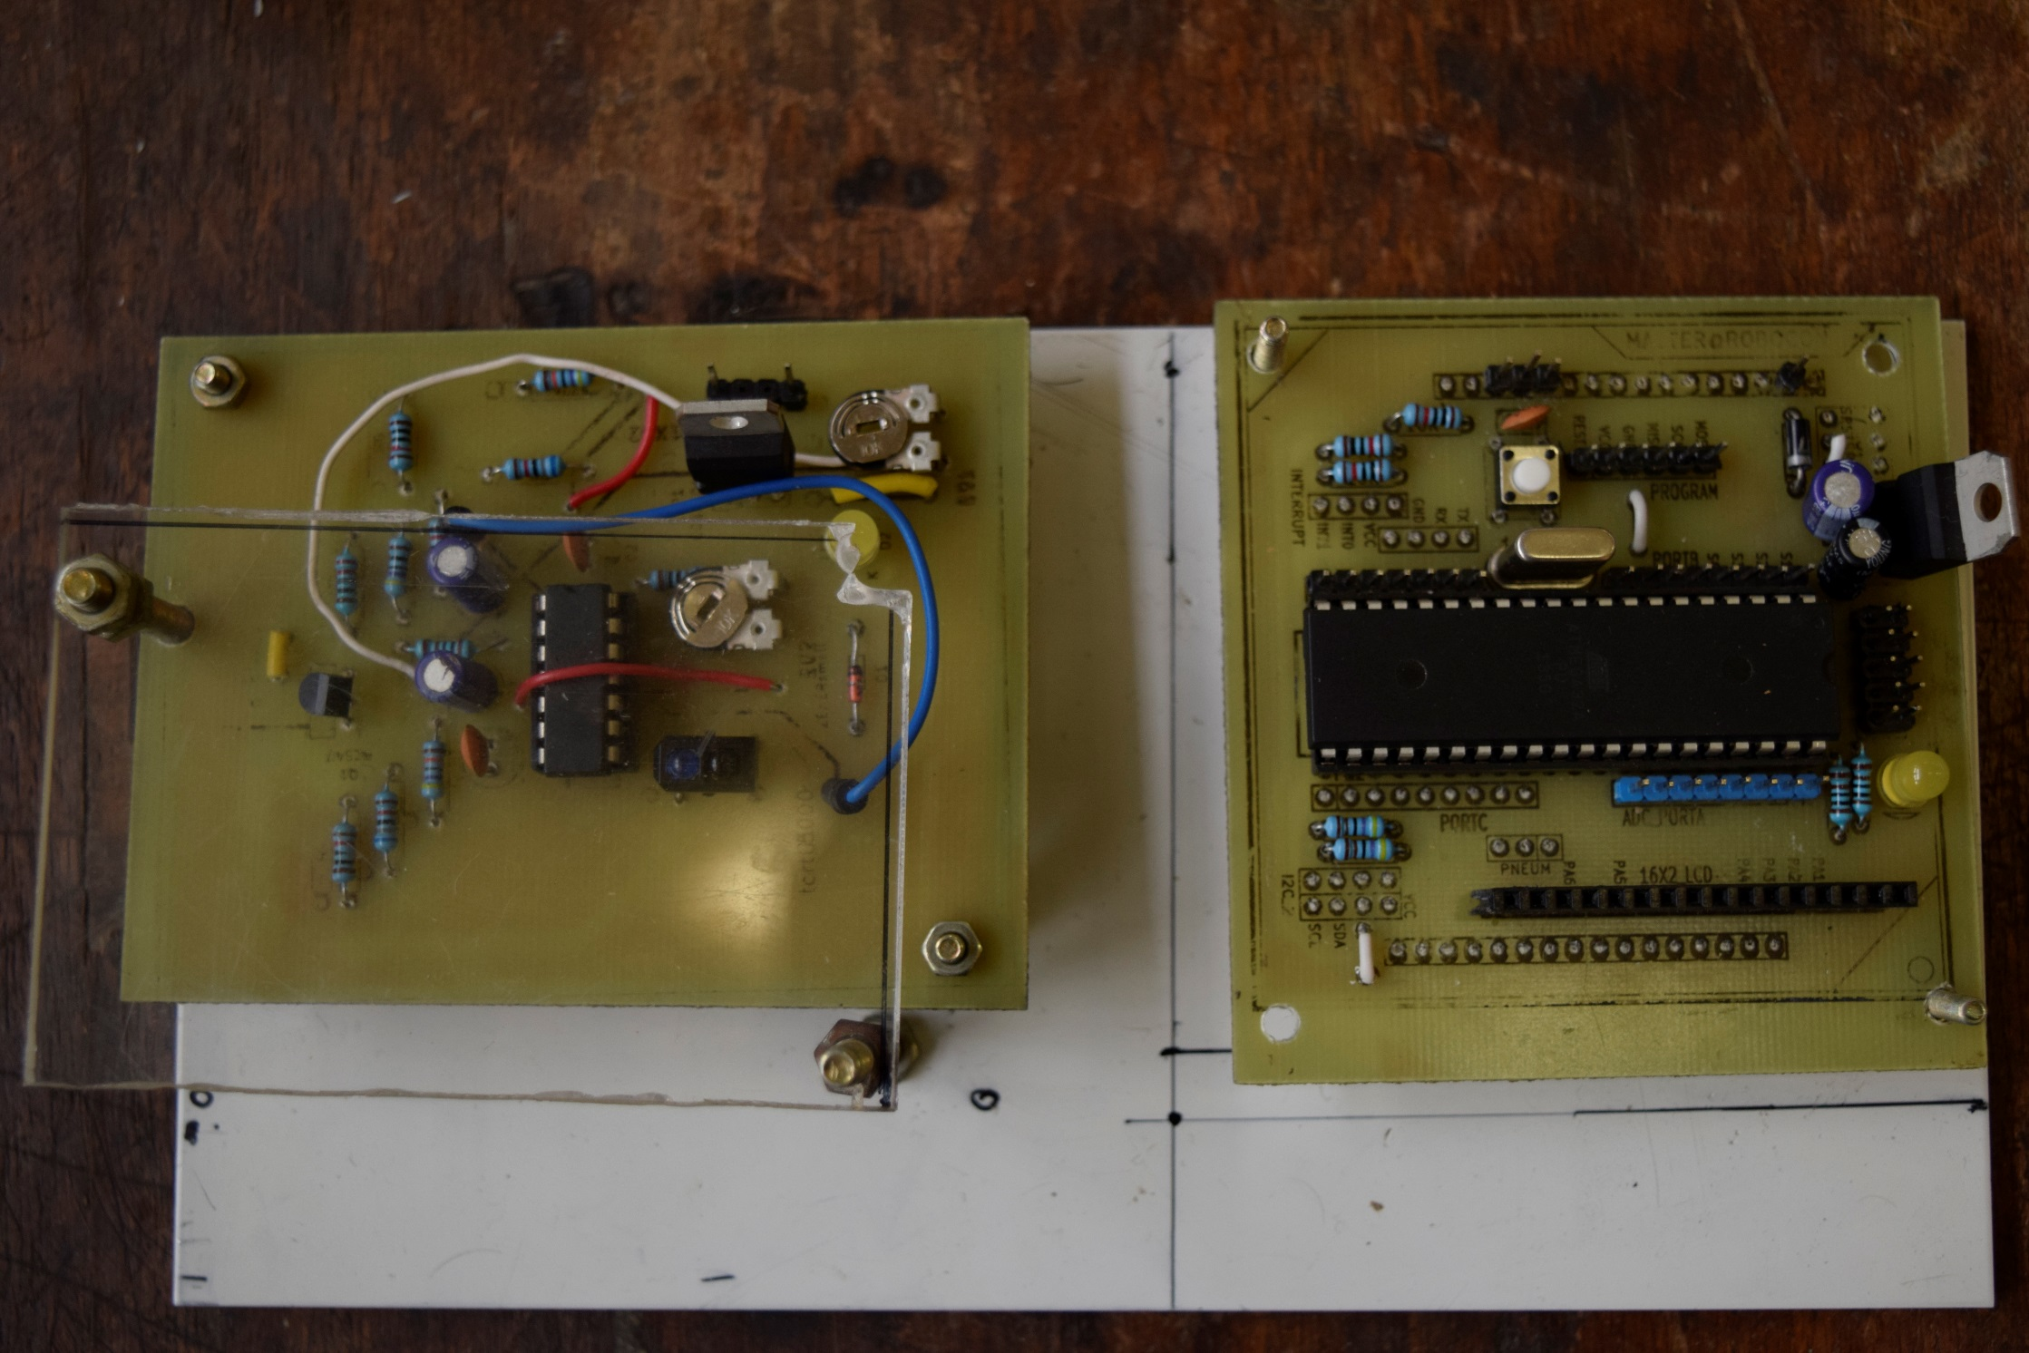

Slide 21
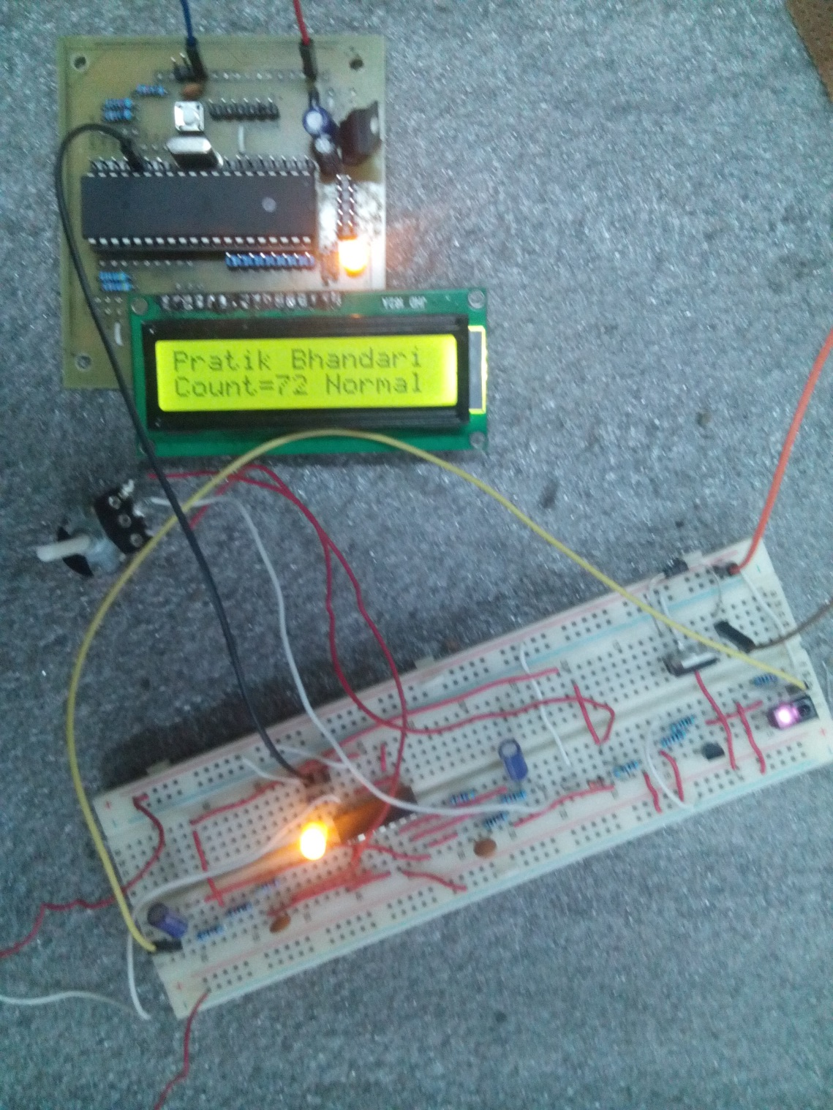

Slide 22
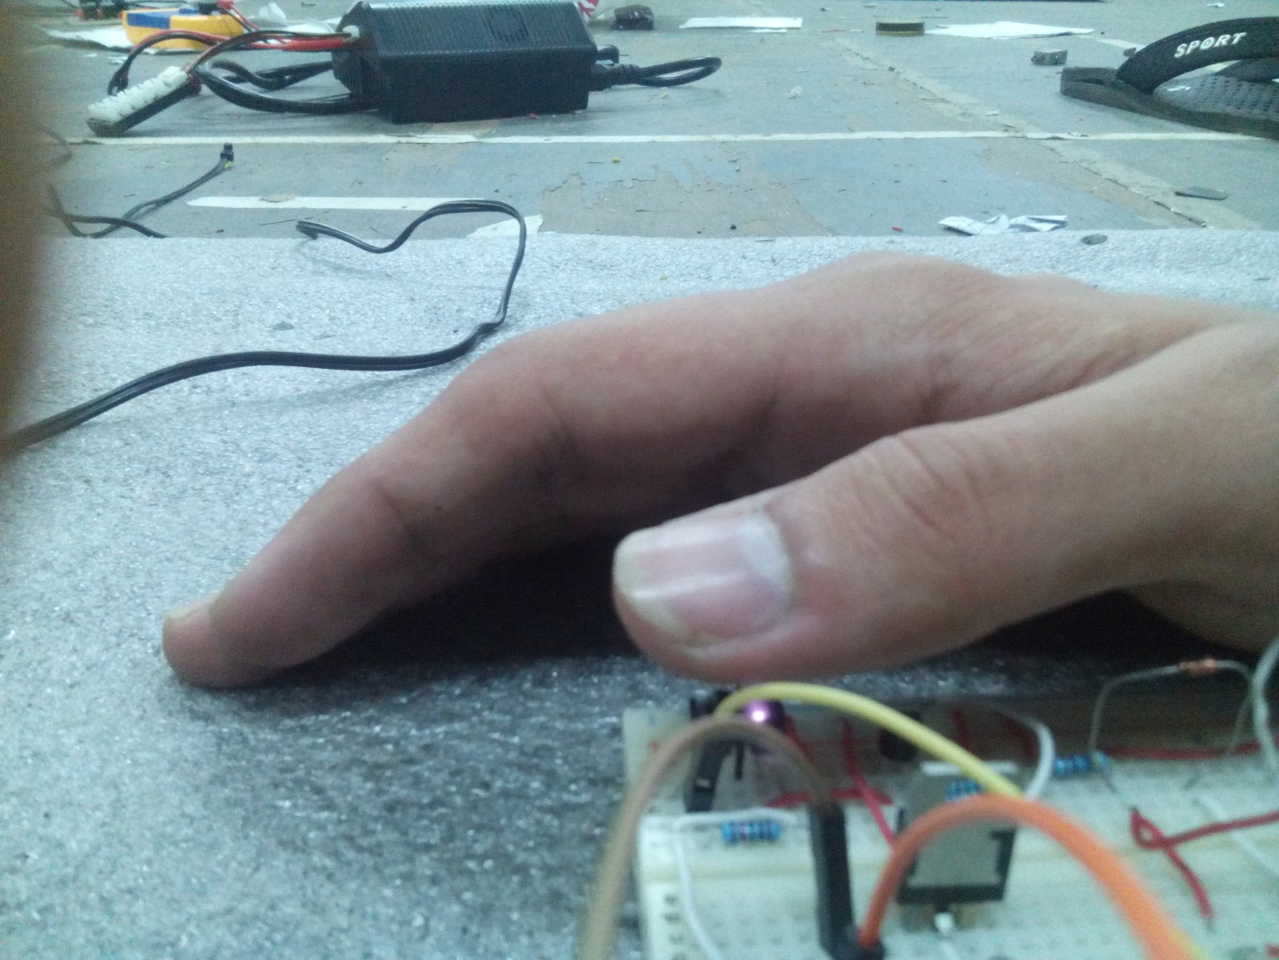

Slide 23
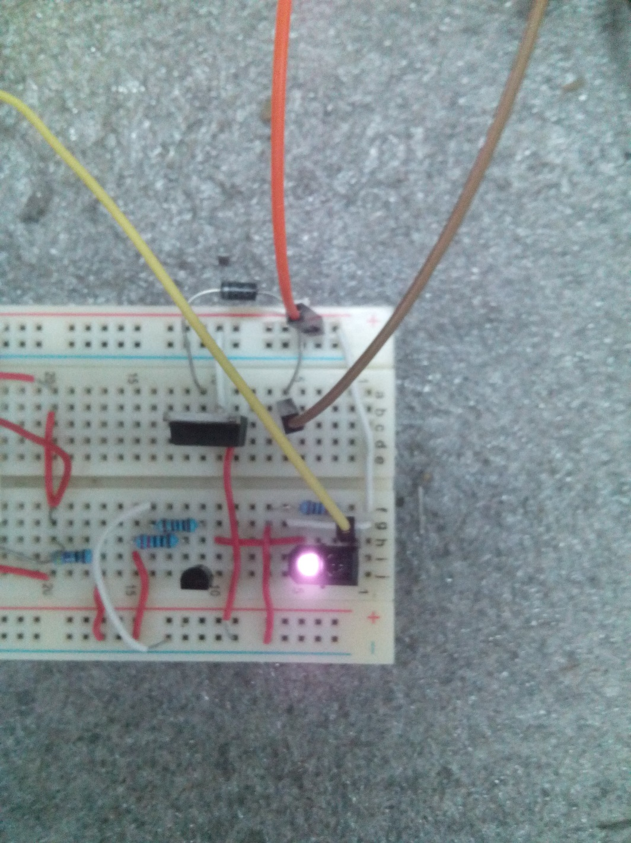

Slide 24
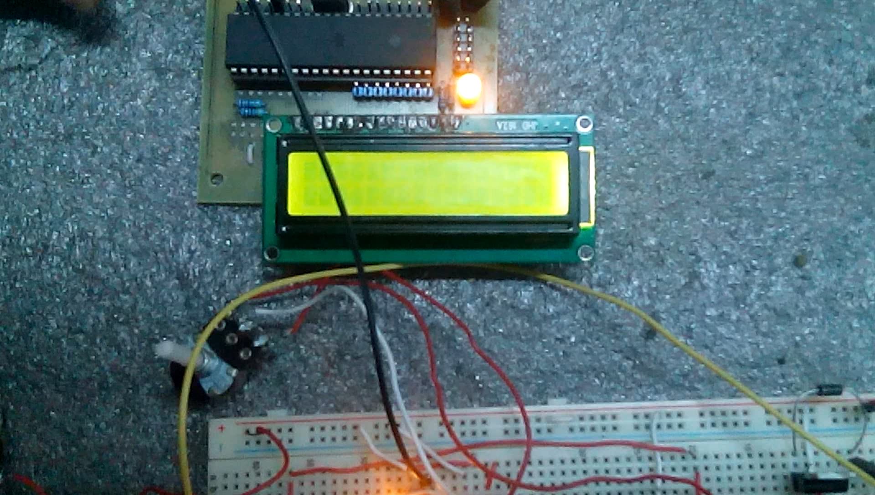

Slide 25
THANK YOU

